Slide 1


CSE 477s - Spring 25
DEEP LEARNING
RESEARCH ON PAPER :
“LEARNING MULTI-CLASS SEGMENTATIONS FROM SINGLE-CLASS DATASETS “
Michael Sameh 2100322
Michael Hany 2100333
Adham Abdelaal 2100725
Research Paper : Learning Multi-Class Segmentations From Single-Class Datasets by Konstantin Dmitriev and Arie E. Kaufman Stony Brook University, Stony Brook, NY
https://openaccess.thecvf.com/content_CVPR_2019/papers/Dmitriev_Learning_Multi-Class_Segmentations_From_Single-Class_Datasets_CVPR_2019_paper.pdf

Slide 2

What is the Problem ?
Semantic segmentation—the task of labeling every pixel in an image—is crucial for applications like autonomous driving ,biomedical imaging and urban scene understanding However, training accurate models requires large datasets with dense, multi-class annotations, which are extremely time-consuming, expensive, and sometimes impractical to create.
The Real-World Limitation:
Most existing datasets only annotate one class at a time (e.g., cars in one dataset, pedestrians in another).
Annotating all classes together (e.g., Cityscapes) is rare and costly.
This leads to a key question ?: Can we train a model to segment multiple classes without any multi-class labeled data?

Slide 3
WHAT THIS PAPER TACKLES?
A unified, class-conditioned segmentation network trained using only single-class datasets, that still performs multi-class segmentation at inference.
LET’S DIVE IN !!
What is NEW?
The Paper introduce a new method that:
Combines multiple single-class datasets (each one labels a different object/class)
Uses a technique called “conditioning” to teach a network which class to segment at a time
Objectives of the Paper:
Design a class-conditioned segmentation model.
Train a single network that works across datasets with different single-class annotations.
Enable multi-class segmentation during inference without ever seeing multi-class labels during training.
Evaluate performance across diverse domains to demonstrate generalizability.
“ You don’t need a single dataset that labels everything. You can mix and match datasets, each focusing on just one class “

Slide 4
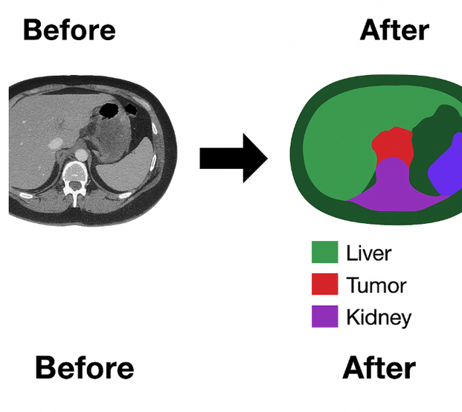
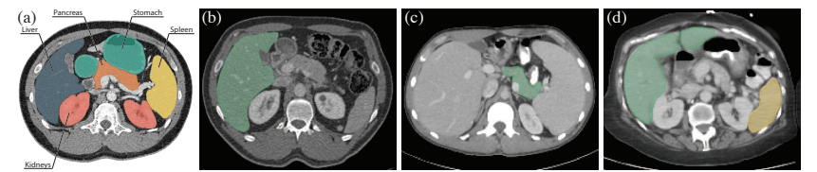
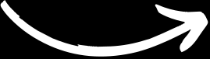
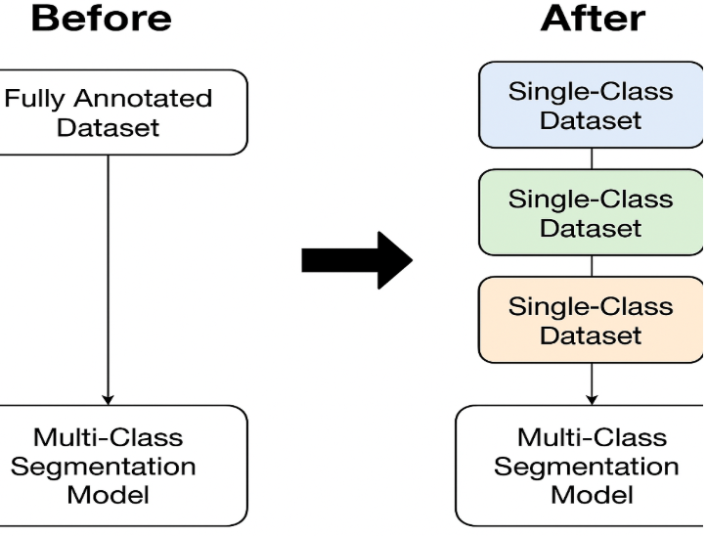
Illustrations :
“ Simplified Explanation Imagine you have Dataset A: Images labeled only for "liver” , Dataset B: Images labeled only for "spleen." and you want to train one model to segment both liver and spleen in new images, without ever seeing a dataset where both classes are labeled together “

Slide 5
Proposed Method :
Base Architecture : A 3D fully-convolutional U-Net with densely connected convolutional blocks with skip connections forming an encoder-decoder structure.
Class Conditioning Mechanism : a class-specific embedding via a hash function that creates a tensor (multi-dimensional array / a 3D block of numbers ) conditioning signal concatenated to intermediate feature maps.
Training Strategy : Train the model with image-mask pairs sampled from diverse datasets, conditioned on the respective class labels, using a binary segmentation loss (DICE COFFICIENT LOSS FN).
Inference Strategy : Sequentially condition the model on each target class at test time to produce multiple binary masks, which are combined into FINALLY a final multi-class segmentation.
Generalization & Efficiency : The model shares parameters across classes implicitly and supports easy addition of new classes with minimal fine-tuning.

Slide 6
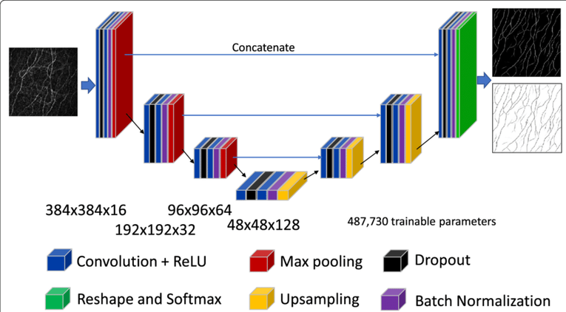

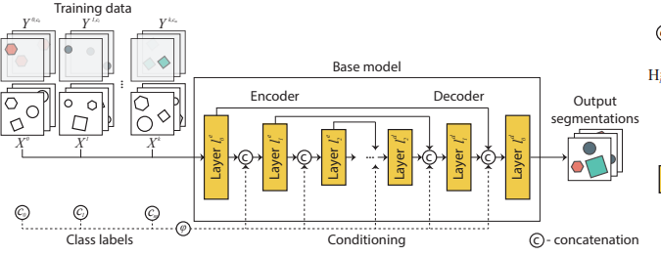
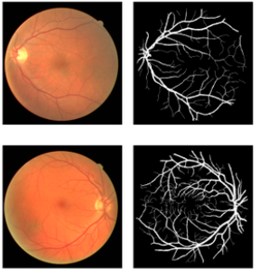
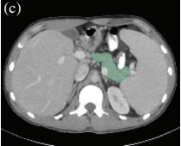

SOME CLARIFICATIONS FOR THE METHODS MENTIONED:
The architecture of U-Net is unique in that it consists of a contracting path and an expansive path. The contracting path contains encoder layers that capture contextual information and reduce the spatial resolution of the input, while the expansive path contains decoder layers that decode the encoded data and use the information from the contracting path via skip connections to generate a segmentation map
The whole process , notice here how conditioning is joining between the feature layers (concatenated to intermediate Feature Maps).
What does conditioning do here?
Conditioning tells the neural network which class it should segment in the input image. Normally, a model trained for segmentation might learn to segment all classes at once or train a separate model for each class. But Here, instead, the network uses a single model and is given a hint “the class label” so it focuses on segmenting only that class at a time , By joining the class tensor with these feature maps, the network knows what object/class it should look for while processing the image.
Conditioning at the decoder has been proven to outperform other options
What is bit masking in segmentation?
A bit mask(binary) is an image where each pixel is either: 1 (True) if it belongs to the object/class of interest, 0 ( False) otherwise.
it Simplifies the problem by Instead of trying to label every pixel with many classes at once, the network only learns to separate foreground (object) from background for a single class in each mask

Slide 7
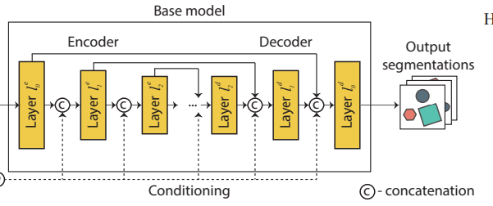
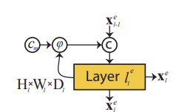

MORE ABOUT CONDITIONING MECHANISM & PERFORMANCE :
“ One of our goals was to keep the base model fully convolutional, simple, and efficient in order to avoid additional overhead that could negatively affect the performance. To achieve this, we propose to incorporate the conditional information as a part of the intermediate activation signal after performing convolutional operations and before applying nonlinearities “
In practice, what happens?
After a convolutional layer produces a feature tensor, they concatenate (or multiply) a tensor encoding the target class label (the conditioning tensor) to the feature maps.
This conditioning tensor is basically a constant "class signal" broadcasted spatially and injected into the feature maps.
The combined tensor then passes through the nonlinearity and further layers.

Slide 8
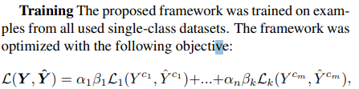
Training Process:
Input Preparation
Each training example consists of:
An input image: X
A class label: c (which class is labeled in this image)
A binary segmentation mask: Y_c (mask for only class c)
All other classes in that image are ignored (masked out with zeros).
Repeat
Over epochs, every class gets enough examples for the model to learn generalized multi-class segmentation through shared features.
Conditioning
The class label c is embedded and broadcasted (via tensor conditioning) to influence the decoder.
This lets the network focus on predicting only the relevant class.
Loss Computation
Compute loss only for the active class (the one you conditioned on).
Common loss function used: Dice Loss or Binary Cross-Entropy (BCE)
Forward Pass
The conditioned U-Net takes (image, class_label) as input.
Output is a single-channel binary mask for that class.
Backpropagation
Backpropagate the loss for just this class-specific prediction.
Model learns to segment each class, one class at a time across the dataset.

Slide 9
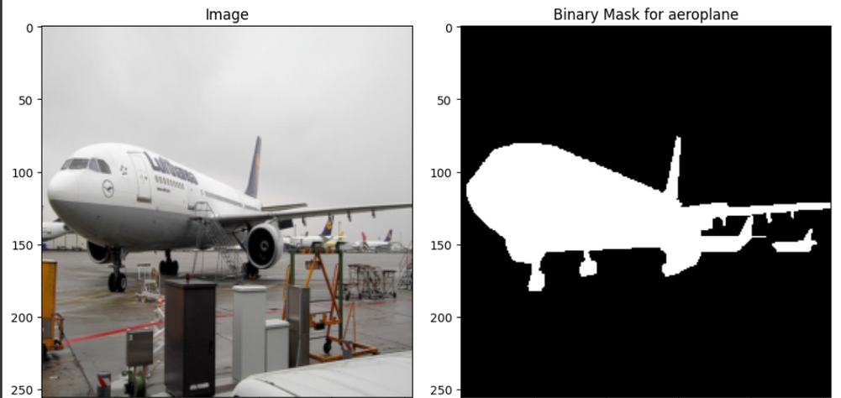
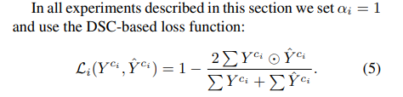
SO NOW WHAT THE OUPTUT WILL LOOK LIKE ?
The network outputs a segmentation mask — a pixel-wise prediction map.
Since the model is conditioned on a single target class at a time, the output is a binary segmentation mask for that specific class.
Each pixel in the output mask indicates whether that pixel belongs to the conditioned class (1) or not (0).
To get a full multi-class segmentation of an image, the network is run multiple times, once for each class:
For each class, you feed the class conditioning tensor and get a binary mask.
Then you combine these masks across all classes to get the final multi-class segmentation map. - as in the figure
SO input is Image + class conditioning , output is binary mask for that class
Now We will Proceed to THE INFERENCE PROCESS

Slide 10
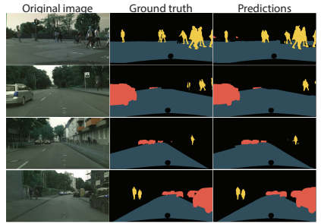
Inference (Testing Phase) :
To produce a full multi-class segmentation map for a new image, even though the model was trained with single-class labels per image.
1.Input an Unlabeled Image
You start with a test image: X_test — no labels or masks are provided.
2.Loop Over All Classes
For each class c (e.g., c = 0, 1, ..., C-1 for C total classes):
Feed the image and the class label c to the model:
3.Stack All Predictions
This gives a multi-channel prediction map, where each channel corresponds to a class.
4.Aggregate to Final Output
Choose the class with the highest confidence at each pixel

Slide 11

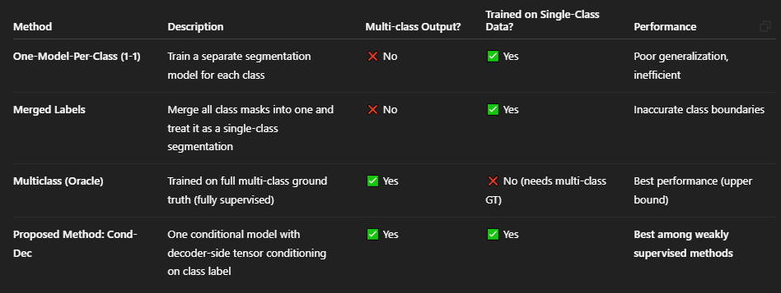
FINAL RESULTS & COMPARISON

Slide 12
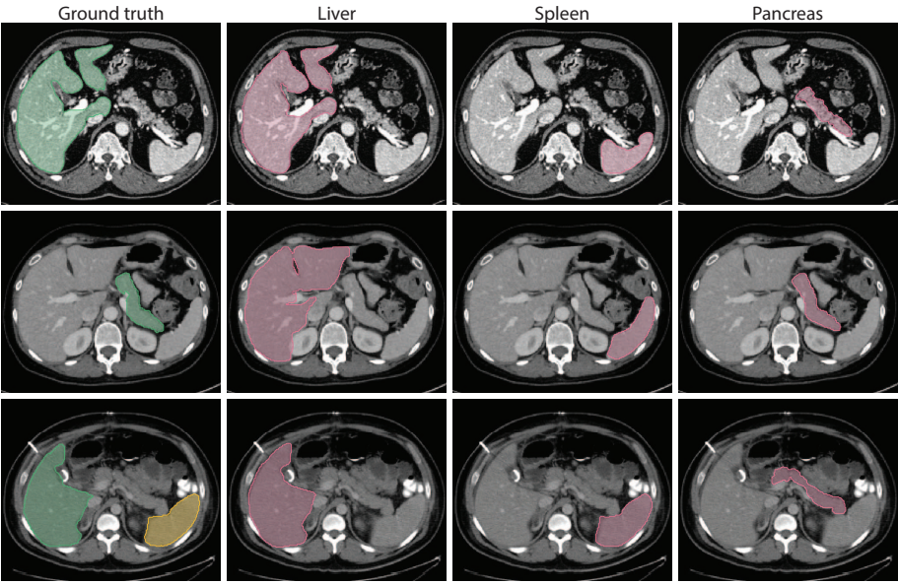
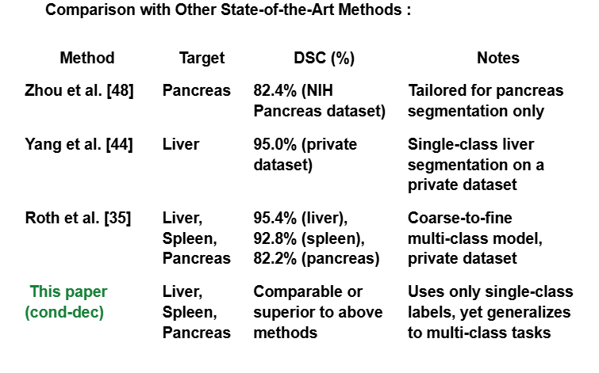
CONLUSION :
In this paper, we described a framework for learning multi-class segmentations from single-class datasets by a novel way of conditioning a convnet for the purpose of multi-class segmentation. The proposed framework was evaluated on the task of segmentation of medical images, where the problem of single-class datasets naturally arises. While being significantly more computationally efficient, the method outperforms current state-of-the-art solutions, which were specifically tailored for each single-class dataset. Additionally, we demonstrated the applicability of our method to the semantic segmentation of natural images using the Cityscapes dataset

Slide 13
THANK YOU!

